Slide 1

My Linear Relationships Interactive Notebook
Name
Class
Term 3 Semester 2

Slide 2
Contents
Formula Page
Page
Date
Description
2
3

Slide 3
Tasks
24
7
30
Essential Question
Questions
Notes
Summary
12
13

Slide 4
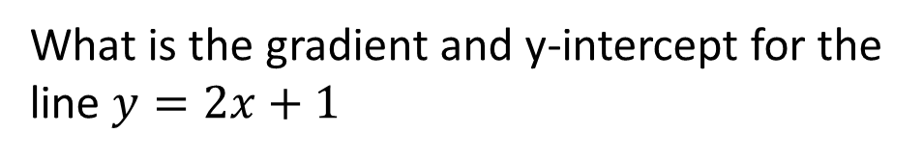



24
7
30
Date
Finding the equation of a line
EQ – Describe how the gradient and y intercept can be used to find the equation of a line
The equation of a line has the form
$$y=mx+c$$
Gradient
y intercept
What is the gradient and y-intercept for the line $y=2x+1$
Gradient = 2/1
Gradient = rise = 2
run 1
$$y intercept=1$$
$$intersection with y−axis$$
13

Slide 5
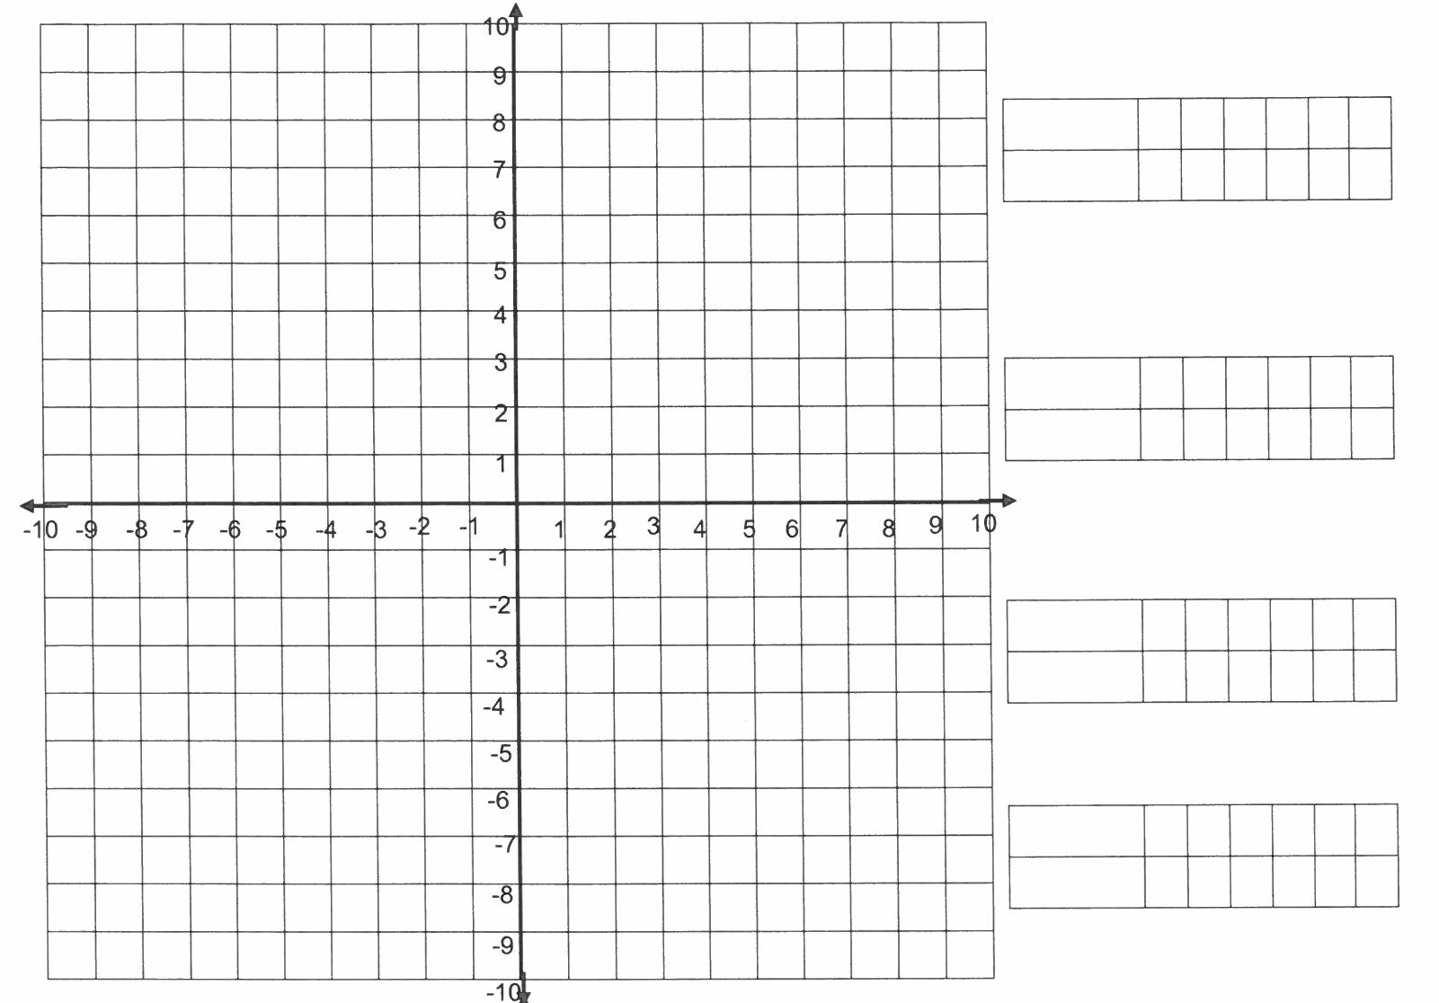
Y = 2x + 1
Y intercept = 1
Rise = 2
Run = 1

Slide 6
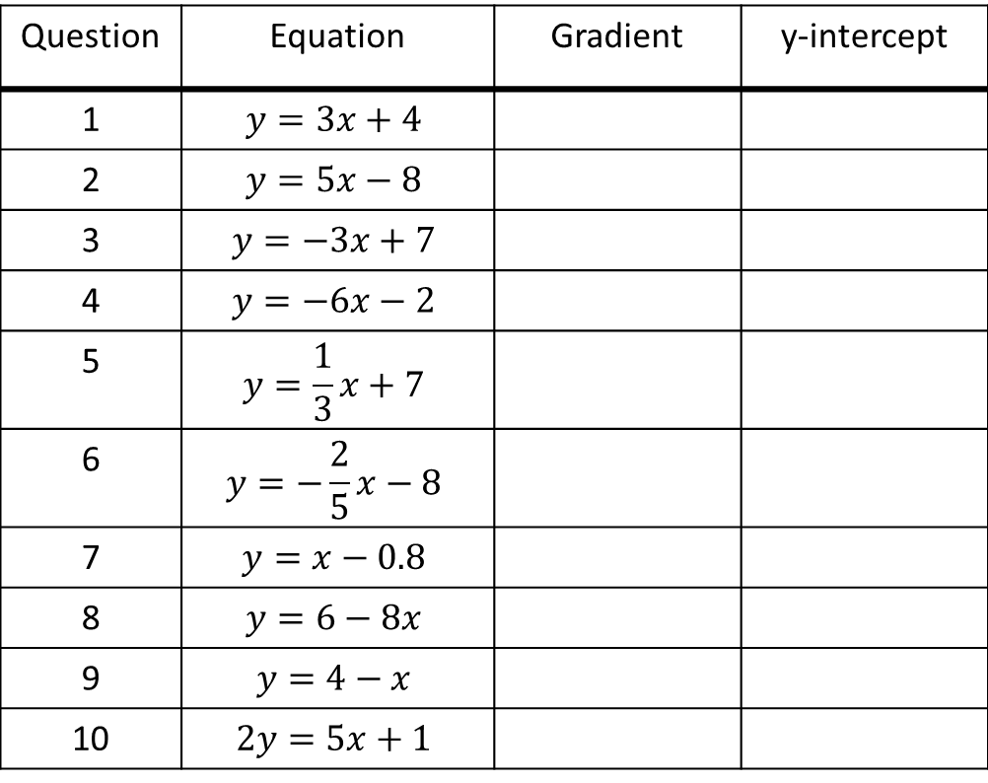
Task – Fill in the table
Question | Equation | Gradient | y-intercept
1 | $$y=3x+4$$
2 | $$y=5x−8$$
3 | $$y=−3x+7$$
4 | $$y=−6x−2$$
5 | $$y=\frac{1}{3}x+7$$
6 | $$y=−\frac{2}{5}x−8$$
7 | $$y=x−0.8$$
8 | $$y=6−8x$$
9 | $$y=4−x$$
10 | $$2y=5x+1$$

Slide 8
Questions Exercise 4.C Pages 208 - 211

Slide 9
Notes Review
24, 7 ,30
Date
Title
Essential question
Notes complete
Notes complete with colour and diagrams
Questions completed
Contents page filed in
Formula page filled in

Slide 10
Homework
Review your notes and write a summary answering the essential question.

